Slide 1
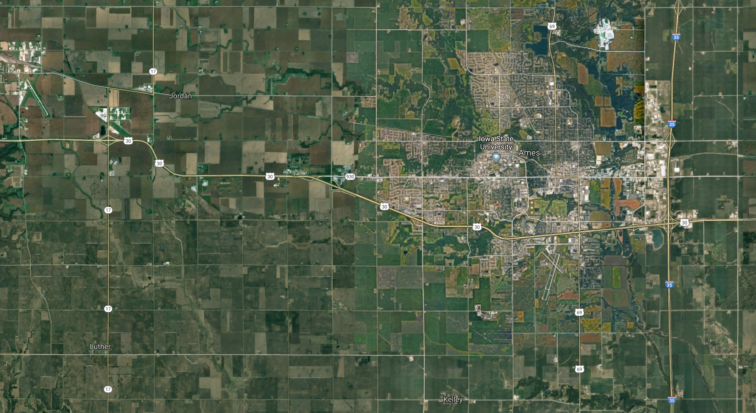
Zillow Housing Prediction Drew Hoppes
Ames, IowA

Slide 2

MODEL WorkFLOW
MUNGING DaTA
FEATURE ENGINEERING & NORMALIZATION
TUNING and Evaluation
EVALUATION
Areas For IMPROVEMENT

Slide 3
MUNGING DATA
Date Data - 4 Variables were entered as integers and needed to be converted to number of years since data occurred assuming the data was collected in 2010. Removed old dates..
ORDINAL DATA – THERE WERE A NUMBER OF QUALITY METRICS THAT WERE CATEGORIZED WITH STRING CODES THAT NEEDED TO BE CONVERTED TO ORDINAL NUMBERS INCLUDING EXTERIOR, HEATING AND KITCHEN QUALITY.
Null Handling – THERE WERE 27 VARIABLES WITH NULL VALUES
DUMMY DATA- ALL REMAINING STRING DATA NEEDED TO BE DUMMIFIED. THERE WERE SOME ORINDAL FEATURES THAT HAD GENUINE N/A’S THAT WE HAD TO KEEP AS DUMMY DATA

Slide 4
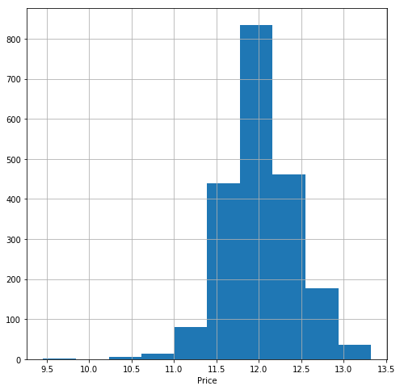
Feature Engineering & NORMALIZATION
POLYNOMIAL FEATURES – USED POLYNOMIAL FEATURES TO GENERATE INTERACTOR VARIABLES BETWEEN THE CONTINUOUS VARIABLE DATA.
CONVERTED THE PREDICTOR VARIABLES TO THE LOG OF Y DUE TO IT’S SKEW.
USED THE STANDARD SCALER TO COMPUTE THE Z SCORE – A METRIC ROUGHLY BETWEEN -3 AND 3 THAN LETS YOU KNOW WHERE A NUMBER LIES ON IT’S DISTRIBUTION.

Slide 5
TUNING and evaluation
BECAUSE WE USED POLYNOMIAL FEATURES, WE HAD A NUMBER OF VARIABLES THAT WERE ON A LARGE SCALE.
BECAUSE OF THIS I CHOSE TO USE THE LASSO REGRESSION, WHCH IS AN OPTIMIZATION EQUATION OF THE LINEAR REGRESSION THAT PENALIZES VARIABLES THAT DON’T CONTRIBUTE TOWARDS PREDICTING AN OUTCOME.
R^2 score range ON MY FINAL MODEL . 93
Alpha = .0066
23,363 RMSE

Slide 6
AREAS for IMPROVEMENT
MORE SELECTIVE FEATURE ENGINEERING INSTEAD OF TAKING A MORE PASSIVE APPROACH AT FEATURE GENERATION
OUTSIDE DATA
NEW MODELS

